Slide 1
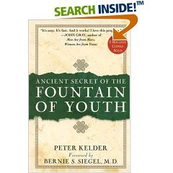
Fountain of youth
Fantasy or future reality???
Dr Mona Shroff MD

Slide 2
The Fountain of Youth by Lucas Cranach the Elder

Slide 3
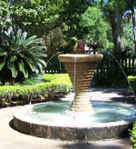
Alexander the Great (356–323 B.C.) described encountering a fountain of life, and Ponce de Leon (1460–1521) purportedly discovered Florida while seeking the fountain of youth.

Slide 4
Don's Fountain of Youth

Slide 6
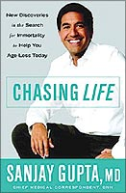
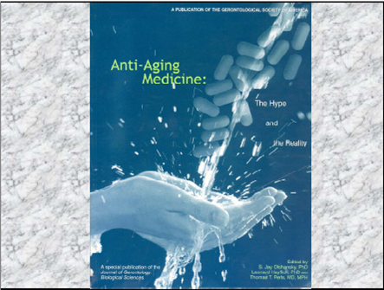

Slide 8
Outward appearance is overemphasized, while the most important characteristics of youth—energy, resilience, flexibility, balance, and strength—are often overlooked

Slide 9
Healthy aging—not antiaging—is the most appropriate and encouraging way to look at turning back the clock

Slide 10
There is a fountain of youth: it is your mind, your talents, the creativity you bring to your life and the lives of people you love. When you learn to tap this source, you will truly have defeated age.
Sophia Loren

Slide 11
We can help ourself age well, especially when it comes to
Avoiding the four biggest health risks of aging: cancer, diabetes, cardiovascular disease, and osteoporosis.
An upsurge in energy levels
An enhanced enjoyment of life and daily activities
A noticeable increase in the sharpness of mind
A stronger sex drive

Slide 16
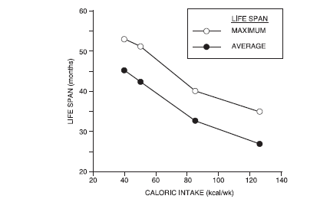
Calorie restriction (CR)

Slide 17
CALORIE RESTRICTION = FOUNTAIN OF YOUTH
Upto now calorie restriction is the only nongenetic intervention that can slow aging in mammals

Slide 18
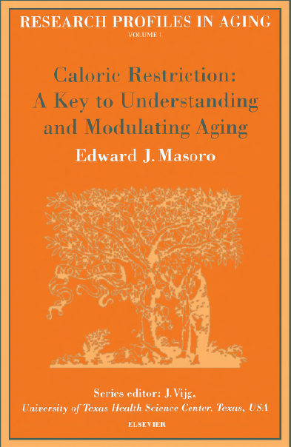
Calorie restriction (CR) refers to a dietary regimen low in calories without undernutrition,with adequate content of essential nutrients (not a “poor” diet, but a low-calorie, healthy diet)

Slide 19
It works either way !!!!!!!
Reduced overall caloric intake
Periods of fasting.

Slide 20
How CR works?
1. Retarding Growth (Mccay 1935)
2. Reduction of body fat
3. Reduction in metabolic rate
4. Oxidative damage attenuation hypothesis-- CR retards accumulation of oxidatively damaged molecules.
5.CR-Protein turnover
6. Hormesis hypothesis--Beneficial action resulting from the response of an organism to low-intensity stressor

Slide 21
7.SIR2 (silent information regulator 2)
Low glucose --- Increase cellular respiration--- more NAD --- activate SIR2 ---Silent rDNA --- Less extrachromosomal rDNA circles--- Extending life span

Slide 22
Extends life expectancy by 30% to 40% if initiated in early adulthood, and by about 20% if initiated in early middle age.

Slide 23
Start now!
Whether you are 20-something or 70-something, you are the CEO of your body, and it’s up to you to manage it.

Slide 29
EXERCISING THE AGING BRAIN
Continued cognitive stimulation improves cognitive abilities
Engaging in mental workout cosistently and continually increasing the level of difficulty is the key to success

Slide 30
New research shows your brain cells continue to regenerate into your older years, meaning you can still try to stay as mentally sharp at 85 as you were at 35.

Slide 31
Youth really does come in all ages.
We know eighty-year-olds whose eyes and smiles sparkle like they just came home from their first date. Their laugh lines are dimmed by the smiles on their faces. We meet twenty-year-olds who look like they’ve already lived eighty years. For one reason or another, their outlook is dark and dreary even though they still have so much ahead of them.

Slide 34
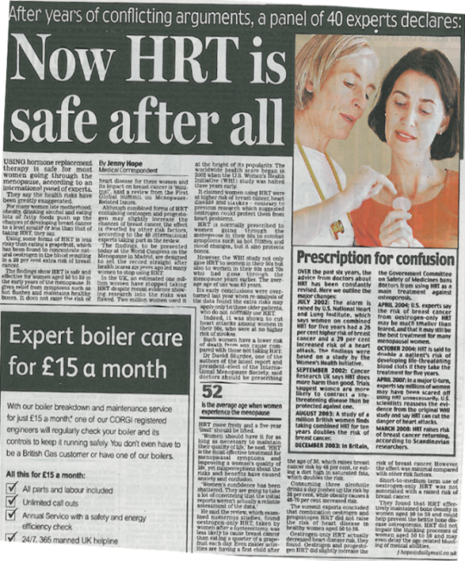
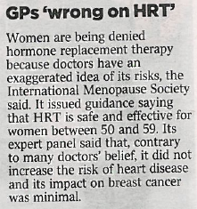
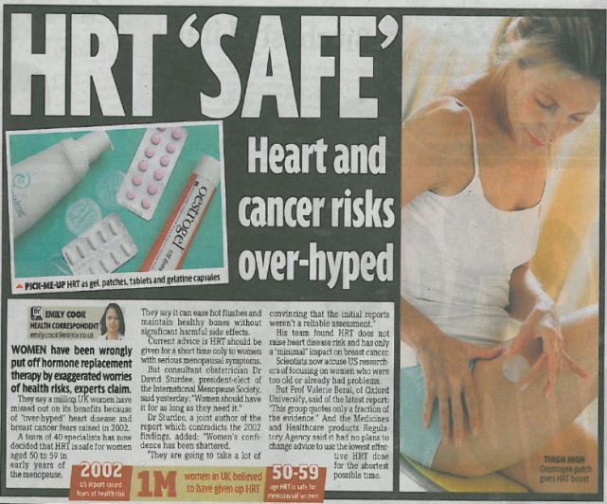
IS HRT THE FOUNTAIN OF YOUTH ???
The Telegraph
BBC News
HRT in older (over 60 yrs) menopausal women does not demonstrate overall health benefit; it is not the fountain of youth; there are balanced benefits and risks.
HRT used in the peri and early postmenopause may be of benefit; ongoing studies are testing this.
Use of HRT for symptoms is appropriate, the lowest dose should be used for the shortest period of time.
Guardian
Daily Mail
The Times
Reuters
Sky News
Daily Mirror

Slide 38
Caloric restriction mimetics
Chemical agents
deprenyl (a drug used to treat Parkinson’s disease in humans) causes a remarkable increase in longevity in old male rats. The mechanism underlying the effects of deprenyl on longevity is notknown.--oxidative stress.
antioxidant
N-tert-alpha-phenylbutylnitrone (PBN) intraperitoneal
nitrone, referred to as CPI-1429,
Melatonin
Phenformin (which lowers blood glucose levels and increases insulin sensitivity)
chromium picolateinfluences carbohydrate metabolism
2-deoxy-D-glucose (2DG)
Aminoguanidine has been found to inhibit the formation of AGE
Alterations of physical activity
Genetically engineered mice

Slide 39
Sexuality in the later part of life is not as much about having
great sex (although that can be a part of it) as it is about
the core essentials of communication and intimacy.
Th ere are ways of expressing sexuality later in life
that are oft en uncharted in our youth—breaking down boundaries
and exploring the benefi ts and importance of intimacy
and communication established through touch, laughter (very
important under any circumstance, but particularly as you get
older), and the confi dence to take risks and try new things.

Slide 40
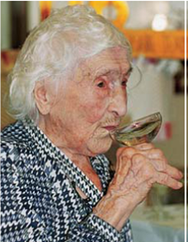
UNLOCKING LONGETIVITY GENE
Current research indicates that it might be possible one day to slow the ageing process by gene therapy.
TELOMERE THERAPY
Stem cells may become each person’s own private fountain of youth and self repair kit.

Slide 45
Bionic solution
Replacing worn out organs

Slide 54
The desire for a quick (and easy) fix
Given a choice, most people will take the quick fix over hard work every time.
Lose 25 pounds in a week, guaranteed? Sign me up!
Quit smoking overnight? Here’s my money!
Build a beautiful body in only two minutes a day — and you don’t even have to stand up? That’s for me!

Slide 55
There’s no magic pill for good health and longevity. It takes commitment, work, and sometimes even denial of self — giving up poor eating habits, couch potato lifestyle, and the stressful schedules so many are addicted to — to stay healthy as you get older.

Slide 56
“To resist the frigidity of old age, one must combine the body, the mind, and the heart. And to keep these in parallel vigor one must exercise, study, and love.”
—Charles-Victor de Bonstettin (1867–1947)

Slide 57
Leroy “Satchel” Paige:
“How old would you be if you didn’t know how old you are?”

