Slide 1
SACROSPINOUS FIXATION

Slide 2
Aim
This surgery offers support to the upper vagina minimizing risk of recurrent prolapse at this site. The advantage of this surgery is that vaginal length is maintained.
Any prolapse surgery is aimed to correct the anatomical problem, relieve symptoms and restore function.

Slide 3
History
Zweifel’s first attempts in 1892 to secure the vault to the sacrotuberous ligament
Success was described by Richter in 1968.
Randall and Nichols introduced the operation to the United States in 1971.

Slide 4
This procedure has now become the key technique of all prolapse treatments via a vaginal approach, and is usually associated with anterior and posterior operational procedures & concomitant surgical repair of other vaginal defects

Slide 5
INDICATIONS
Posthysterectomy Vault Prolapse
Accompanying Vaginal Hysterectomy for procedentia/excess vaginal eversion
For Uterine Suspension

Slide 6
PATIENT SELECTION
Identify all the site-specific vaginal defects present.
Accurate identification of the at-risk patients for urinary incontinence would determine which patients should have an anti-incontinence procedure.
The only specific preoperative requirement for a sacrospinous colpopexy is adequate vaginal length.
Consideration of systemic or local estrogen therapy before surgery

Slide 7
The technique and indications for this intervention, originally described as a vaginal approach for the treatment of post-hysterectomy prolapses,have undergone many adaptations. The principle, however, has remained unchanged, and is based on suspension of the vaginal vault to the right or left sacrospinous ligament via a suture thread passed through the vaginal wall on one end and the ligament’s width at the other end.

Slide 8
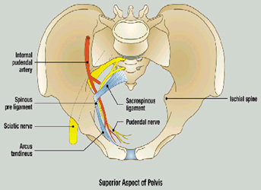

Slide 9
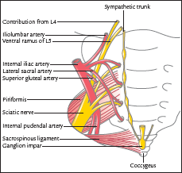

Slide 10
STEPS OUTLINE
The posterior vaginal wall is opened to the apex and the rectovaginal space is entered.
The rectovaginal space is dissected(sharp & blunt ) at the level of the ischial spines.
At that time, the descending rectal septum (pillar) is perforated, opening the pararectal space .
With additional dissection, the ischial spine and coccygeus muscle sacrospinous ligament complex are palpated and identified visually.
Long-acting, absorbable sutures or monofilament, permanent sutures are placed through the ligament.
These sutures are held and left untied until any additional reconstructive procedures are finished.
Finally, the ligament fixation is carried out by using both safety and pulley stitches .

Slide 11
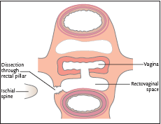

Slide 12
STEPS IN DETAIL

Slide 13
Vaginal infiltration
Place three Kocher/allies forceps in stages along the median part of the posterior vaginal wall, the highest being placed above the vaginal vault,the lowest of the forceps is positioned at the level of the mucocutaneous jn, the third forceps is positioned halfway between the other two.
Held in tension
Saline infiltration under the vaginal thickness, performed precisely in the dissection plane.

Slide 14
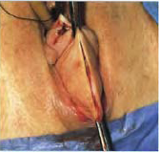
Median vaginal incision

Slide 15
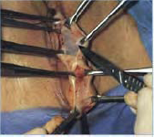
Positioning the Allis’ forceps

Slide 16
Rectovaginal dissection
While the Allis’ forceps are being pulled away from each other, one performs the rectovaginal dissection by incising the infiltrated plane between vagina and rectum This incision is extended by counter-laterally spreading the rectum with a toothless forceps. The dissection can easily be extended with a finger and opening of the pararectal trenches starts at the upper end.

Slide 17
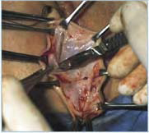

Slide 18
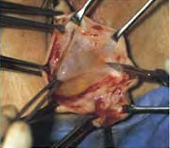

Slide 19
For the incision’s lower part, it is often necessary to lift the rectum with a forceps in order to liberate its lateral and lower attachments. This additional dissection has to be performed before placing the retractors permitting the dissection of the sacrospious ligament, so that pushing back the rectum with the large retractor does not result in a rectal wound from dilacerations at the level of its lateral attachments.

Slide 20
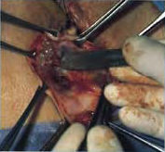
Liberating the lower part of the rectum.

Slide 21
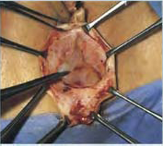
Rectovaginal dissection completed.

Slide 22
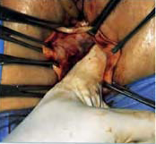
Beginning the opening of the left pararectal fossa.

Slide 23
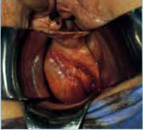
Positioning the three retractors: dissection space, rectum, levator muscle.

Slide 24
Positioning the retractors
First, the posterior retractor is put into place so that the posterior Allis’ forceps can be removed.
Insert the small lateral retractor in contact with the levator muscle.
The medial retractor now inserted & allies removed.This improves the retractors’ mobility, thus allowing enlargement of the operative field .
One must ascertain that the retractor does not reach beyond the levator muscle, masking the dissection space. One must also make sure that the right retractor correctly holds back the rectum. If necessary, a gauze can be placed so that the rectum can be pushed away more efficiently.

Slide 25
Opening the pararectal space
It is necessary to visualise the limit between the levator muscle and rectum
It is recognisable by prerectal fatty tissue belonging to an adherent portion of the levator muscle. This space can easily be opened using a peanut rubbed against the muscle from front to back, pushing back the rectum
Retractors are repositioned

Slide 26
The dissection is performed in contact with the levator muscle
It is a useful point of orientation that will always lead to the sacrospinous ligament. This dissection is carried out away from the ischial spine,
Attention: in the case of prior myorraphy of the levator muscles, this dissection plane can be difficult and one must be careful.

Slide 27
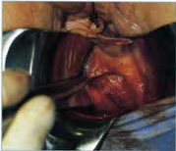
Continuing the opening of the pararectal fossa.

Slide 28
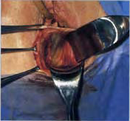
View of the left levator muscle’s dissection.

Slide 29
Dissection of the sacrospinous ligament
Visible as a whitish membrane covering the posterior fibres of the levator muscle before spreading out across the pelvic wall

Slide 30
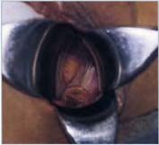
Left sacrospinous ligament.

Slide 31
Attention: Should the ligament not present this characteristic aspect there will be a risk of:
– dissecting beyond the sacrospinous ligament
– major haemorrhage.
In case of doubt, remove the lateral retractor and palpate the ligament, which, even if not always visible, should always be palpable. If the ligament is not palpable, palpate the counter-lateral ligament and choose the most favourable side.

Slide 32
Passing the needle through the ligament
Place two non-resorbable sutures in order to prevent accidental release of one of the sutures during the subsequent manipulation
The ligament’s deep position; its inherent thinness and its position along the wall; the narrow dissection space limiting the radius of needle rotation, and the proximity to the rectum all represent limiting factors.

Slide 33
It is recommended to pass the needle from back to front in order to prevent injury from the needle point to the vascular pedicles that are close to the ischial spine, should the needle deviate from the intended path
Avoid penetrating the full thickness of the ligament or risk injuring any structures behind the ligament.

Slide 34
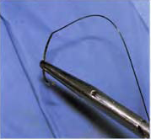
Grasping the suspension needle.

Slide 35
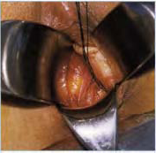
Verify haemostasis and the hold’s stability

Slide 36
Myorrhaphy of the levator muscles
Myorrhaphy of the levator indispensable to complete the process with effective support muscles.
Verification of rectal integrity by rectal examination.

Slide 37
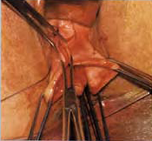
The start of vaginal closure and determining the point of suspension

Slide 38
Vaginal suspension
Vaginal suspension is more delicate, since it must be just as firm but can only be performed on the vaginal tissue itself, and it cannot transfix this tissue if non-resorbing thread is used. This suspension, therefore, represents the weak point of the overall suspension.

Slide 39
Vaginal suspension
This technique was described by Gilles Crépin and consists of the preparation of two vaginal strips, after deciding on the positioning of the vaginal floor. A surface of about 2 cm by 3 cm of the vaginal floor will provide a base of implantation for the strips

Slide 40
Vaginal suspension
Before realising the suspension, begin vaginal closure as far as the representative position of the future vaginal floor.
Using scissors, section a 2-by-3-cm long strip with a wide implantation base relative to the reference point for the vaginal floor
The epidermis is ablated by superficially scratching the strip before piercing it with a needle carrying one of the threads passed through the sacrospinous ligament The same action is performed contralaterally.

Slide 41
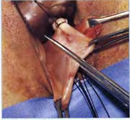
Vaginal strip.

Slide 42
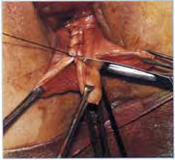
Removal of the strip’s epidermis.

Slide 43
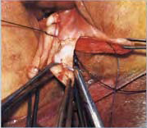
Vaginal strip held with the needle.

Slide 44
Vaginal closure and putting the suspensions under tension
Before putting the Richter suspension threads under tension, it is recommended to carry out a nearly complete closure of the vaginal incision.
Once the crossed overcast suture leaves just enough space for a finger to pass, the threads are put under tension

Slide 45
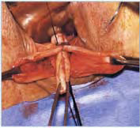
Vaginal closure, and enclosing of the two vaginal strips.

Slide 46
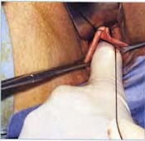
Putting the threads under tension

Slide 47
It is important to gain a close approximation and not to allow a suture bridge between these two structures.
The myorrhaphy thread is also knotted before finishing the overcast suture of the vaginal closure. At this stage, the suspension threads can be cut short.

Slide 48
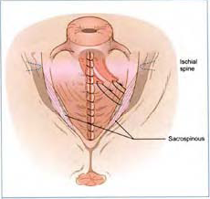
The surgical procedures’ final result.

Slide 49
Complications
Buttock pain 5 -10 %
Bleeding requiring transfusion <1%
Damage to the surrounding organs -<1%
Urinary tract infection occurs in 1-5%
Dyspareunia - 1%
De-novo stress incontinence 0 to 10%
Failure rate (lifetime recurrence 5-10 %)
Anterior compartment defects

Slide 50
Buttock pain
Buttock pain on the side that the sacrospinous sutures have been passed occurs in 5-10% women .
This can be very painful but usually fully subsides by 6 weeks.
The pain could be due to haematoma formation at the site of suture insertion or could be secondary to trauma to nerve fibres in the substance of the ligament.

Slide 51
Haemorrhage
Elements of the operation that may carry particular risk:
Suture placement along the posterior ligament,
Traumatic placement of retractor placement beyond the ligament,
Overly aggressive denuding of the ligament/levator surface,
Excessive medial traction against the rectum and presacral area

Slide 52
Haemorrhage
In the case of a operative haemorrhage originating in the pararectal fossa, pressure is applied with a compress to the wound and the retractors are replaced in order to obtain a good viewing.
If a localised haemorrhage persists after compression, a haemostatic stitch can be carried out.
In the case of a strong haemorrhage of the pudendal pedicle that is not accessible for haemostasis, the compression is prolonged. Gauze pack put into place for haemostasis by compression. A follow-up procedure planned 48 hours later for removal of the gauze drain and verification of haemostasis.
Liga clips, low-pressure hydrostatic balloon,arterial embolisation

Slide 53
Rectal injury
These are of several types:
– Injury caused during recto-vaginal dissection,
– Injury caused by the positioning of the retractors: at the lower part of the dissection of the pararectal space.
In the case of doubt, perform a rectal examination, as well as a dye test.
In the case of a rectal injury, it has to be sutured and the quality of the seal verified by applying another dye test. The patient is put onto a residue-free list rectum. This rectal examination does not replace verification of the rectum’s integrity as required during the check for haemostasis

Slide 54
de-novo stress incontinence
Considering the low incidence of stress incontinence after sacrospinous colpopexy, it would seem that barrier testing may overestimate the incidence of incontinence.
To include an anti-incontinence step as a routine procedure in all women with urodynamic evidence of stress incontinence is, therefore, unjustified.
When the procedure is performed in conjunction with routine anterior colporrhaphy and suburethral buttressing,there is a very low incidence of de-novo stress incontinence. The introduction of procedures that pull the para-urethral tissues anteriorly appears to increase complication rates while simultaneously reducing the success of the prolapse repair.

Slide 55
The combination of sacrospinous colpopexy with retropubic suspension may predispose to failure of the prolapse procedure
The approach to de-novo stress incontinence should be expectant. In some cases the condition will settle over a period of time without any further intervention; this probably reflects a gradual relaxation of the anterior wall supports, leaving only a small number of patients who will require a second procedure to deal with the incontinence.

Slide 56
Nerve injury
Any evidence of direct injury to the sciatic or pudendal nerves would require immediate reoperation to remove the suture.
Re-positioning could be achieved at the same time, thus ensuring a successful outcome.

Slide 57
FAILURE
Poor approximation between the vault and the ligament. Suture bridge---no fibrosis
Cut through from vaginal side
Depends on a multitude of factors, including the quality of endopelvic connective tissues, postoperative convalescence, lifestyle factors, and the repair of all coexisting pelvic floor support defects at the time of surgery.
No difference if delayed absorbable/nonabsorbable suture; unilateral /bilateral
If a unilateral procedure fails, it can be repeated on the contralateral side. Fibrosis and scarring make a repeat procedure on the same side virtually impossible.

Slide 58
Anterior wall defects
Fixation of the upper vagina in a more retroverted position may predispose the anterior wall to excess pressure and subsequent cystocele formation.
Many patients with anterior wall defects remain asymptomatic

Slide 59
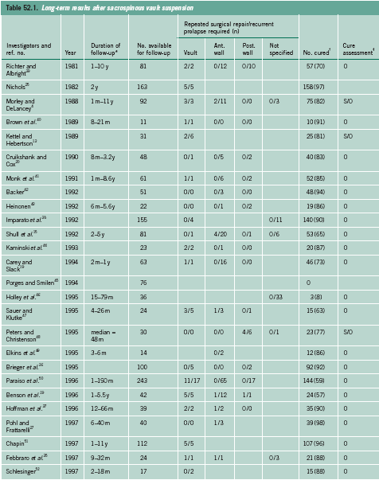

Slide 60
TECHNICAL VARIATIONS

Slide 61
Exposing the Ligament-
Posterior vaginal incision
“Anterior” sacrospinous suspension technique
Apical approach
Similarly, some surgeons prefer to realise the passage through the ligament in a blind fashion, orienting themselves by palpation

Slide 62
Suture Placement
Deschamps ligature carrier.
Miya hook ligature carrier
Schutt arthroscopic needle holder (also called a caspari needle Holder)
Use of specific materials(staples, Endostitch…).
Standard long curved needle holder to be sufficient

Slide 63
Unilateral vs bilateral sacrospinous fixation
No definite results
Morley and delancey concluded that there was no reason to perform a bilateral attachment.
Subsequently, a few authors have proposed that a bilateral sacrospinous fixation should be the procedure of choice, as it provides superior vaginal support. A recent description includes an analysis of what percentage of patients have sufficient vaginal capacity to undergo a bilateral procedure.
Most favour the right-hand side unilateral procedure owing to the mechanical advantage afforded to right-hand-dominant surgeons, and the anatomic advantage resulting from the absence of the sigmoid colon on the right.

Slide 64
Choice of suture material
Consensus does not exist over the choice of suture material.
Initially, absorbable sutures were used, whereas more recent papers advocate the use of a combination of absorbable and non-absorbable sutures.

Slide 65
Vaginal anchoring
Leave about 2cm of vaginal tissue intact at the apex, so as to be able to run the two pulley sutures under this segment of intact vagina
Anchoring sutures are secured to the undersurface of the posterior vaginal cuff epithelium

Slide 66
Comparison with abdominal procedures
vaginal procedures for the treatment of prolapse carry less potential for morbidity than the abdominal alternatives.
shorter operating time
less postoperative pain
shorter hospital stay.
allows a symptomatic cystocele or rectocele to be repaired with the same surgical approach.
complications of the abdominal procedure - infection and erosion of the synthetic graft material.
compromised health, obesity and multiple previous laparotomies-vaginal preferable
The literature suggest that the two approaches have similar success rates

Slide 67
Conclusion
Sacrospinous fiation is an easy & safe procedure for the support of upper & mid vagina
Easy to learn & easy to teach
Almost equivalent success rates with much lesser morbidity as compared to its alternatives

